Slide 1
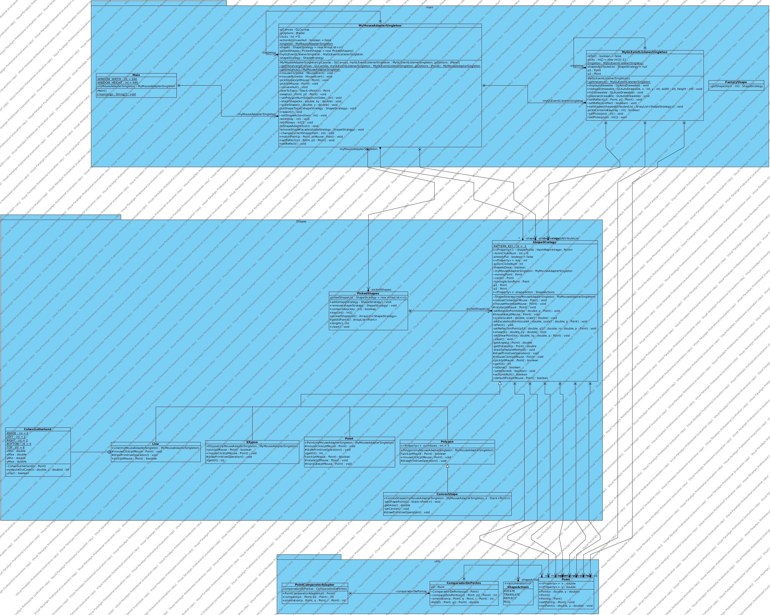
Diagrama de classes do MyPaint

Slide 2
Classes Singleton e Factory

Slide 3
Classe Strategy

Slide 4
Classe Adapter

Slide 5
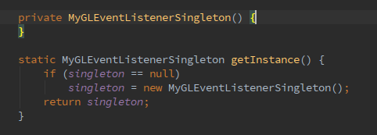
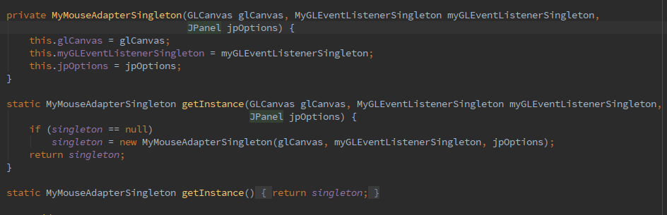
Singleton
Classes Singleton – MyMouseAdapterSingleton, MyGLEventListenerSingleton.

Slide 6
Factory Method
Usa a classe abstrata ShapeStratgy e suas subclasses.
Devolve a MyMouseAdapterSingleton a subclasse escolhida.

Slide 7
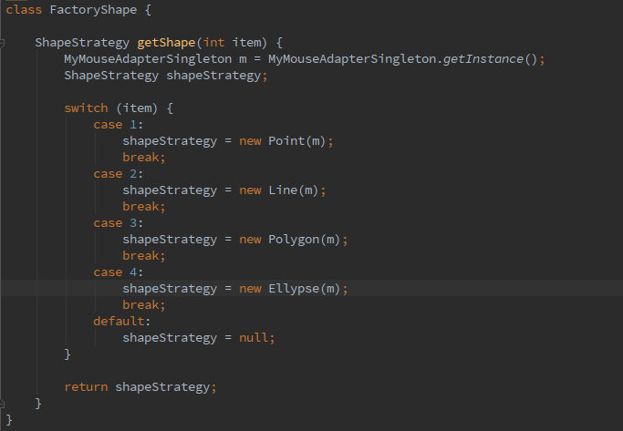

Slide 8
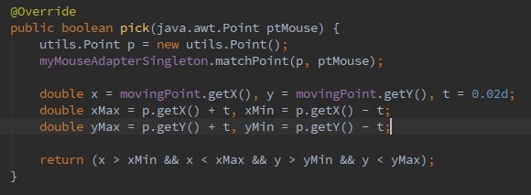
Strategy
Classe abstrata – ShapeStrategy
Classes concretas – Point, Line, Polygon, Ellypse;
Classe Context - MyMouseAdapterSingleton

Slide 9
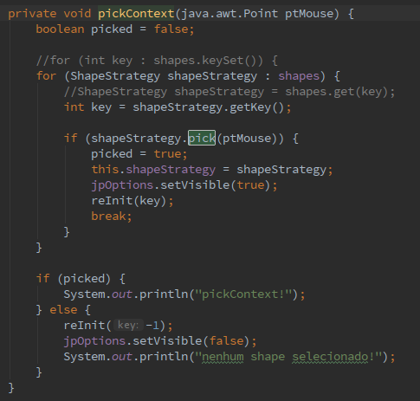

Slide 10
Template Method
Classe abstrata – ShapeStrategy
Método Template - drawTemplateMethod()
Método abstrato – drawPrimitiveOperation()
Implementado por todas as subclasses

Slide 11
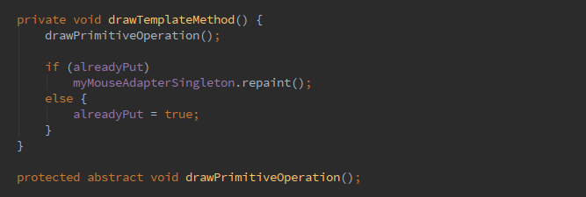


Slide 12
Adapter
Classe adaptada – ComparadorDePontos
Classe Adapter – PointComparatorAdapter
Interface – Comparator<>
Cliente - MyMouseAdapterSingleton

Slide 13
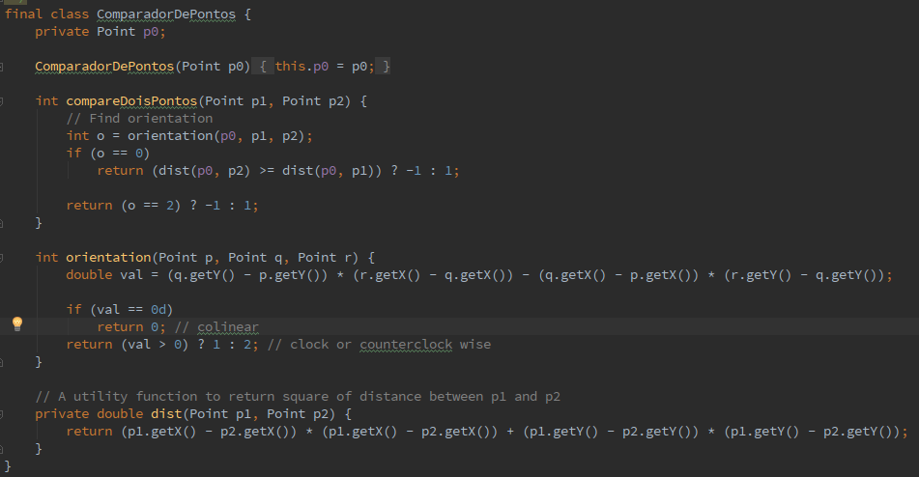

Slide 14
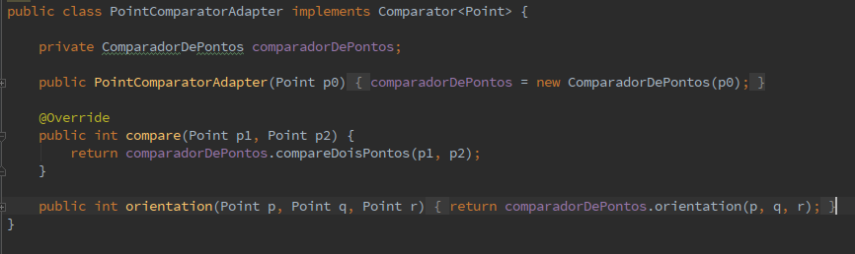


Slide 15
Facade
Cliente - Main
Classe Facade – MyMouseAdapterSingleton
Metodo Facade – convexHullFacade()
Classes do subsistema – PickedShapes, ShapeStrategy, MyGLEventListenerSingleton, Point, PointComparatorAdapter, Stack<>, ConvexShape etc.

Slide 16


